Slide 1
Chapter 1. Introduction
Data mining and machine learning
Machine learning and AI
Data Science, Data mining
AI advances

Slide 2
Data Mining
Data mining (knowledge discovery from data)
Extraction of interesting (non-trivial, implicit, previously unknown and potentially useful) patterns or knowledge from huge amount of data
Alternative names
Knowledge discovery (mining) in databases (KDD), knowledge extraction, data/pattern analysis, data archeology, data dredging, information harvesting, business intelligence, etc.
Data Science
Data Science is the extraction of actionable knowledge directly from data through a process of discovery, hypothesis, and analytical hypothesis analysis.

Slide 3
Machine Learning (ML)
Machine learning (ML) is a branch of artificial intelligence, and as defined by Computer Scientist and machine learning pioneer Tom M. Mitchell:
“Machine learning is the study of computer algorithms that allow computer programs to automatically improve through experience.”
ML is one of the ways we expect to achieve AI. Machine learning relies on working with small to large data-sets, by examining and comparing the data to find common patterns and explore nuances.

Slide 4
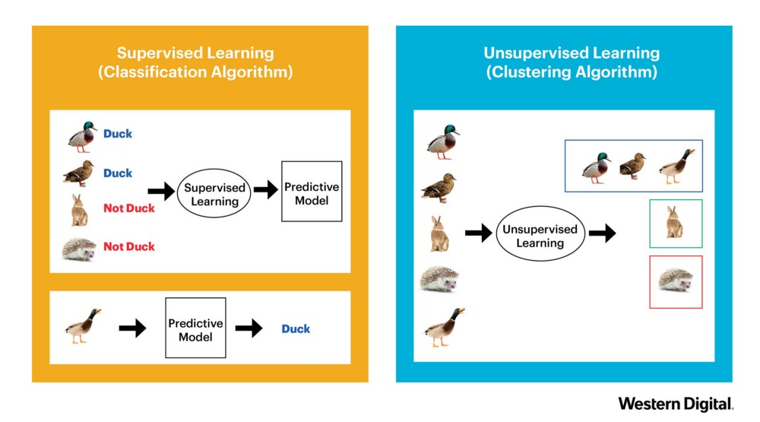
Supervised vs. unsupervised

Slide 5
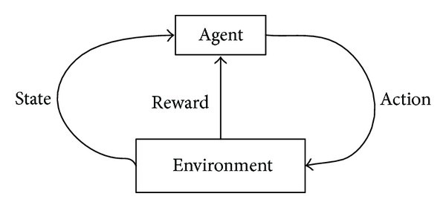
Reinforcement Learning
Q-learning, Policy gradient

Slide 6
Data Mining and Machine learning

Slide 7
Machine Learning Methods

Slide 8
Machine Learning Approaches
Decision Tree Learning: Using multi-way tree to make categorical decisions
Naïve Bayes Classifier: Using Bayes theorem to find the maximal likelihood class of an instance
Artificial Neural Networks (ANN): Learning algorithm that is inspired by the structure and functional aspects of biological neural networks
Support Vector Machines (SVM): Using optimization method to find the maximal margin separating plane for classification and regression

Slide 9
Machine Learning Approaches
Regression: using least square error principle to fit a linear model
Association Rule Learning: Discovering interesting relations between variables in large databases
Clustering Analysis: Grouping sample data into clusters with similar properties or some predefined criteria
Deep Learning: Using big data to train deep neural network (CNN)

Slide 10
Machine Learning Approaches
Representative Learning: Based on preserving the input information and transforming it as a pre-processed data for other classification algorithms (PCA, Autoencoder)
Reinforcement Learning: Based on how an agent ought to take actions in an environment to maximize some notion of long-term reward

Slide 11
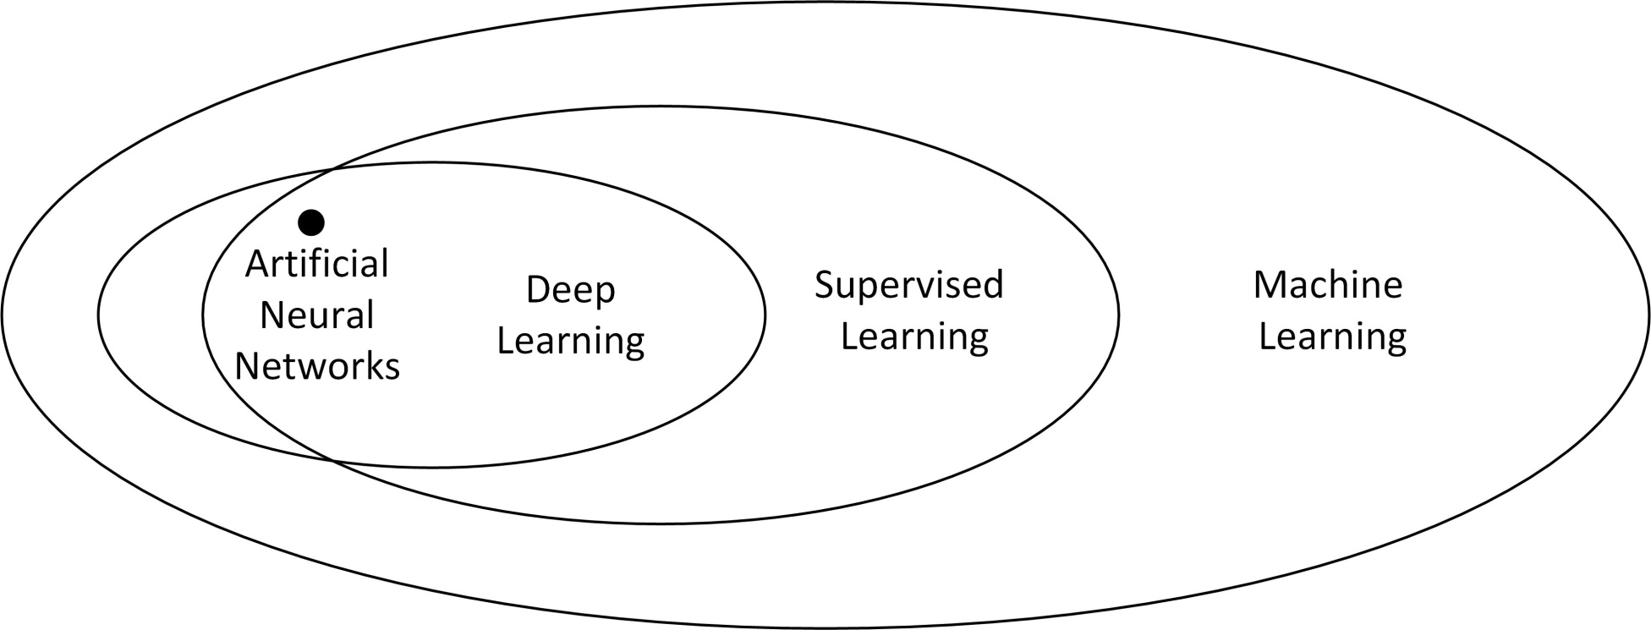
Evolution of Deep Learning from ML and ANN Approach
Notes:
11

Slide 12
AI, ML, DL
Artificial Intelligence
Machine Learning:
Regression
Decision tree
Support vector machine
Artificial neural network
Deep learning
Clustering
Bayesian algorithm
Genetic algorithm
Nature-inspired algorithms
Association rules
Regularization (to prevent overfitting)
Ensemble algorithms
Machine Learning
Deep learning:
Conventional neural networks (CNN)
Recurrent neural network (RNN)
Long Short-Term Memory (LSTM)
Generative Adversarial Networks (GANs, 2014)(生成式對抗網路)
Reinforcement learning (強化學習)
Neural Networks
Deep Learning

Slide 13
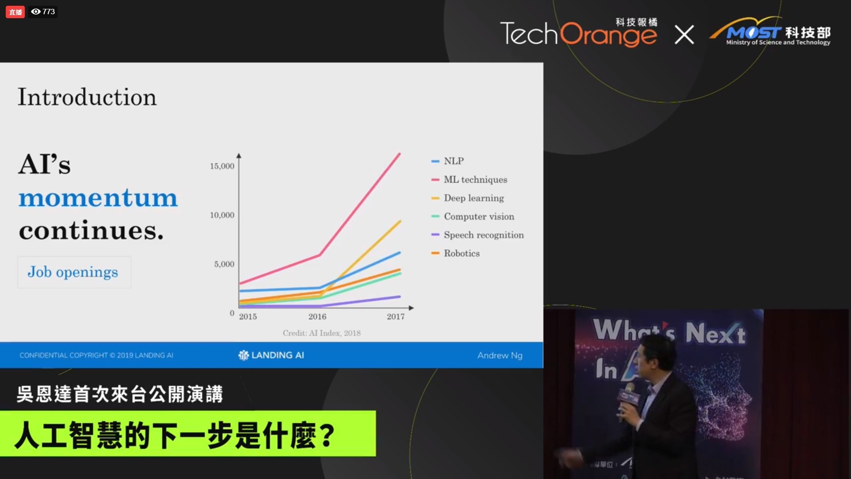

Slide 14
AI definition
Simply put, Artificial intelligence (AI) is an area of computer science that aims at emphasizing the ability of machines to behave the way humans do, which includes complex tasks such as observing, learning, planning and making decisions for problem-solving (1956, John McCarthy).

Slide 15
AI definitions
One of the definitions (by Kai-fu Lee 李開復 2019):
Deep Learning + Big Data=AI
AI we draw you a chart. An article talked about AI
In March of 2019, three deep learning masters earned Turing Awards (Nobel prize in Computer Science)
Jeoffery Hinton、LeCun Yann and Yoshua Bengio
Next: Ian Goodfellow for GAN ( generative model), Guys(?) inventing Transformer, Guys creating models for and training ChatGPT

Slide 16
What is Data Science ?
Data Science is the extraction of actionable knowledge directly from data through a process of discovery, hypothesis, and analytical hypothesis analysis.
A Data Scientist is a practitioner who has sufficient knowledge of the overlapping domains of expertise in business needs, domain knowledge, analytical skills and programming expertise to manage the end-to-end scientific method process through each stage in the big data lifecycle.
Big Data refers to digital data volume, velocity and/or variety whose management requires scalability across coupled horizontal resources
Functional components of data science supported by some software libraries on the cloud in 2016

Slide 17
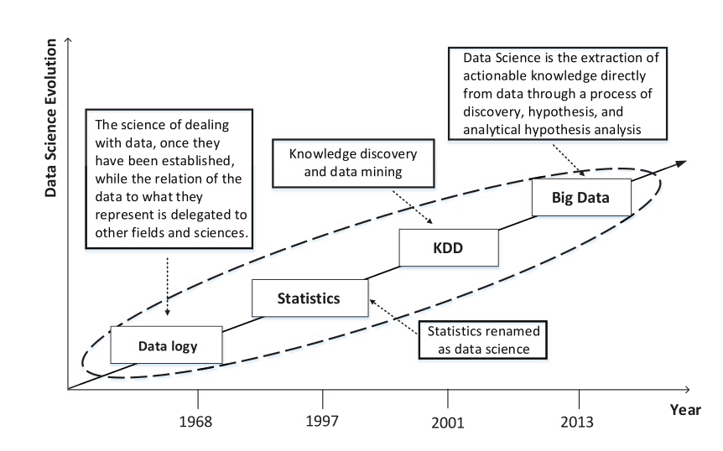
The Evolution of Data Science
Summarized below are some open challenges in big data research, development and applications.
Structured versus unstructured data with effective indexing;
Identification, de-identification and re-identification;
Ontologies and semantics of big data;
Data introspection and reduction techniques;
Design, construction, operation and description;
Data integration and software interoperability;
Immutability and immortality;
Data measurement methods;
Data range, denominators, trending and estimation.
The evolution of data science up to the big data era
Notes:
1968, the data science also called data logy, the science of dealing with data, once they have been established, while the relation of the data to what they represent is delegated to other fields and sciences. Go to 1997, the data science is equivalent to statistics, such as Bayes clustering, categorizing the data. Basically the math department like to do this XXX, it still care about the raw data, that’s not target to some very specific application, and Go to KDD, KDD is popular since 2001, it actually has two part, first part the data mining, the second is knowledge discovery, you got the raw data, you need to mining them, then base on the data you preprocess or mining the data , you do further programming analytics, you can generate knowledge, that’s why it called knowledge discovery, but they does not XXX data scale, when go to big data area, the data science the definition is changed, it’s the extraction of actionable knowledge directly from data through a process
of discovery, hypothesis, and analytical hypothesis analysis.

Slide 18

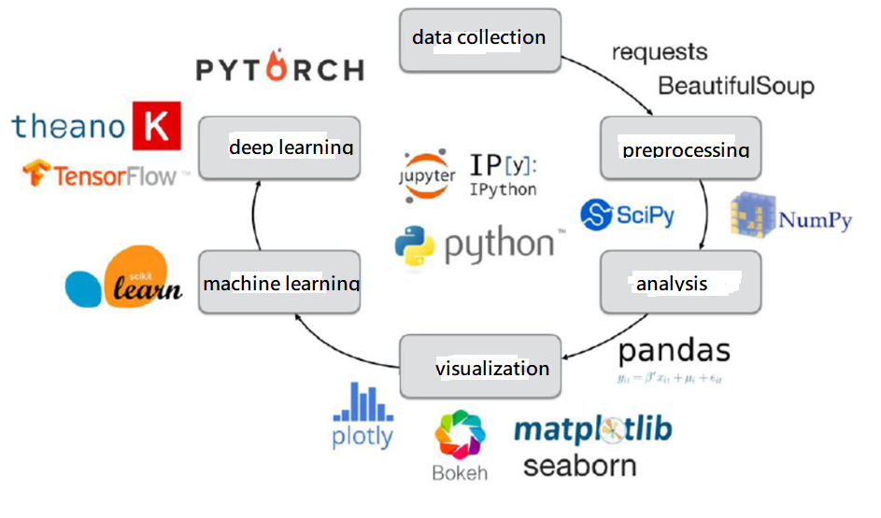
Path of Machine Learning & Deep Learning

Slide 19
Data Mining: Classification Schemes
General functionality
Descriptive data mining (Clustering, Association rules)
Predictive data mining (Classification, Regression)

Slide 20
Data Mining Functionalities
Frequent patterns, association, correlation vs. causality
Diaper → Beer [0.5%, 75%] (Correlation or causality?)
Classification and prediction
Construct models (functions) that describe and distinguish classes or concepts for future prediction
E.g., classify countries based on (climate), or classify cars based on (gas mileage)
Predict some unknown or missing numerical values

Slide 21
DM Tools
Integrated GUI: Weka
Languages: R, Python
Specifically, in this course, you will learn Python, Data science for Python & many DM models using Scikit Learn
For deep learning (AI next semester), Keras + Tensorflow (or PyTorch)

Slide 22
10 ML Algorithms
10 ML algorithms (Andrew Ng, 吳恩達)
10 ML algorithms

